Slide 1
IITISoC’24 IVR3: MICROMOUSE
Final Report

Slide 2
Table of Contents
The Problem Statement
Initial Approach
Final Iteration & Metrics
Stepping Up!
Optimised Algorithm
Final Simulation
Hardware Elements Required
Sensor Selection
Microcontroller Selection
Motors Selection
Motor Driver Selection
Power Source Selection
Further Vision

Slide 3
The Problem Statement
In the PS, the task was to make a robot that will be able to navigate a maze and autonomously decide and calculate the fastest path and run to the goal of the maze.
This mouse will need to demonstrate how the interconnection of hardware and software can function together to accomplish a task.
There are two main parts in the micro mouse software:-
● The software to bridge the hardware devices
● The maze algorithms
First, an algorithm will be selected to scan the physical maze and after scanning the maze an algorithm should be selected to find the shortest path from the starting position to the goal.

Slide 4
Initial Approach
We proposed an initial approach of selecting a maze algorithm by exploring a wide array of options & testing them in various environments.
Once the algorithm is selected, we would optimize its efficiency.
Then we were to select hardware components like sensors, microcontroller, motors. motor driver & power source.
Then we were to implement tweaks like diagonal turning and vacuum fan for even more efficiency in physical environments & the micromouse will choose the fastest path .

Slide 5
Final Iteration & Metrics
We successfully analysed various algorithms like DFS, BFS, Dijkstra’s, A*, Flood Fill etc. & ended up selecting Flood Fill as the most suitable one for our micromouse robot. We kept in mind factors like maze searching time, shortest path guarantee, algorithm complexity while choosing.
We optimized Flood Fill algorithm to take a different rout back to the initial position so that it is almost certain to find the shortest path in the return trip completely ignoring the irrelevant areas of the maze and producing optimum results.
We dropped the plan for implementing diagonal turning and vacuum fan as we had to consider factors like cost and dimensions, also it is easier to implement in physical environment as the mms simulator doesn’t have the option.
The complexity of our algorithm is moderate which matches the maze complexity and going for more complexity feels like a bit unnecessary.

Slide 6
Stepping Up!
Until the Mid-Evaluation, we had chosen Flood Fill algorithm suits our requirements the best. Now it’s time to dive deeper and optimize it within the constraints.
Simulating the final algorithm would be the end for software part of this project. #Step1Completed
Next Step is to decide upon the hardware elements that are required to bring this micromouse to life. For achieving that we again need to explore various options available of different components to produce maximum efficiency.
The personal criteria for choosing the right hardware components will include Low power consumption, moderate complexity (no need for overkill), adaptability, compact size & relative compatibility.
Let’s GO!

Slide 7
Optimized Algorithm
By the end of Mid-Evaluation, our Flood Fill algorithm with return trip was already able to find the shortest path while avoiding the irrelevant parts of the maze completely.
After that we have optimized it to take the faster path (having less turns) even if it is not the shortest path. This improves the score as the micromouse doesn’t have to slow down to take more turns again & again.
Following is our final algorithm:

Slide 8
import API
import time
from Direction import Direction
from Maze import Maze
from Mouse import Mouse
from collections import deque
def floodFillManhattanDistances(maze, goals):
width = API.mazeWidth()
height = API.mazeHeight()
distances = [[None] * height for _ in range(width)]
queue = deque([(goal[0], goal[1], 0) for goal in goals]) # Using deque for efficient pop from the front
for goal in goals:
distances[goal[0]][goal[1]] = 0
while queue:
x, y, dist = queue.popleft() # pop from the front of the deque
for direction in Direction:
if maze.getWall((x, y), direction):
# if x !=0 and x!=15 and y!=0 and y!=15:
# API.log(f'continued at {x},{y} in drin {direction}')
continue
else:
nx, ny = getNeighbor((x, y), direction, maze)
# API.setText(nx,ny,f'{maze.getWall((x, y), direction)}')
if maze.contains((nx, ny)) and distances[nx][ny] == None:
distances[nx][ny] = dist + 1
# API.setText(nx,ny,f'{distances[nx][ny]}')
# time.sleep(0.01*distances[nx][ny])
queue.append([nx, ny, distances[nx][ny]])
return distances
def getNeighbor(current, direction, maze):
x, y = current
if direction == Direction.NORTH:
y += 1
elif direction == Direction.EAST:
x += 1
elif direction == Direction.SOUTH:
y -= 1
elif direction == Direction.WEST:
x -= 1
return (x, y)
def moveTowardsSmallestDistance(maze, mouse, distances, visited):
current_position = mouse.getPosition()
current_direction = mouse.getDirection()
min_distance = float('inf')
next_direction = None
next_position = None
for direction in Direction:
neighbor = getNeighbor(current_position, direction, maze)
if maze.contains(neighbor) and not maze.getWall(current_position, direction) and neighbor not in visited and distances[neighbor[0]][neighbor[1]] != None:
if distances[neighbor[0]][neighbor[1]] < min_distance:
min_distance = distances[neighbor[0]][neighbor[1]]
next_direction = direction
next_position = neighbor
if next_position:
while current_direction != next_direction:
if current_direction.turnLeft() == next_direction:
mouse.turnLeft()
elif current_direction.turnRight() == next_direction:
mouse.turnRight()
else:
mouse.turnAround()
# distances = floodFillManhattanDistances(maze, goal_cells)
current_direction = mouse.getDirection()
mouse.moveForward()
current_position = mouse.getPosition()
visited.add(current_position) # Update visited set with the new position
return True # Successfully moved
def getDirection(current, target):
cx, cy = current
tx, ty = target
if tx > cx:
return Direction.EAST
elif tx < cx:
return Direction.WEST
elif ty > cy:
return Direction.NORTH
elif ty < cy:
return Direction.SOUTH
else:
return None
def moveToStart(maze):
width = API.mazeWidth()
height = API.mazeHeight()
distances = [[None] * height for _ in range(width)]
queue = deque([(0, 0, 0)]) # Using deque for efficient pop from the front
distances[0][0] = 0
# for x in range(16):
# for y in range(16):
# API.setText(x,y,f'{distances[x][y]}')
# time.sleep(0.005)
while queue:
x, y, dist = queue.popleft() # pop from the front of the deque
for direction in Direction:
if maze.getWall((x, y), direction):
# if x !=0 and x!=15 and y!=0 and y!=15:
# API.log(f'continued at {x},{y} in drin {direction}')
continue
else:
nx, ny = getNeighbor((x, y), direction, maze)
# API.setText(nx,ny,f'{maze.getWall((x, y), direction)}')
if maze.contains((nx, ny)) and distances[nx][ny] == None:
distances[nx][ny] = dist + 1
# API.setText(nx,ny,f'{distances[nx][ny]}')
# time.sleep(0.005*distances[nx][ny])
queue.append([nx, ny, distances[nx][ny]])
return distances
def main():
begin = time.time()
maze = Maze(API.mazeWidth(), API.mazeHeight()) # Initialize maze dimensions using API
mouse = Mouse(0, 0, Direction.NORTH) # Initialize mouse at starting position
start = (0, 0) # Starting position
# Define the goal cells (e.g., the center of the maze)
goal_cells = [(API.mazeWidth() // 2, API.mazeHeight() // 2)]
if API.mazeWidth() % 2 == 0:
goal_cells.append((API.mazeWidth() // 2 - 1, API.mazeHeight() // 2))
goal_cells.append((API.mazeWidth() // 2, API.mazeHeight() // 2 - 1))
goal_cells.append((API.mazeWidth() // 2 - 1, API.mazeHeight() // 2 - 1))
# Calculate Manhattan distances using flood fill from the goal cells
distances = floodFillManhattanDistances(maze, goal_cells)
visited = set() # Set to keep track of visited cells
visited.add(start) # Mark the starting cell as visited
for i in range(3):
while not maze.inCenter(mouse.getPosition()):
updateWalls(maze, mouse)
distances = floodFillManhattanDistances(maze, goal_cells)
# API.log(distances)
moved = moveTowardsSmallestDistance(maze, mouse, distances, visited)
if not moved:
visited = set()
distances = floodFillManhattanDistances(maze, goal_cells)
moved = moveTowardsSmallestDistance(maze, mouse, distances, visited)
if i < 2:
visited = set()
while mouse.getPosition() != (0,0):
updateWalls(maze, mouse)
distances = moveToStart(maze)
moved = moveTowardsSmallestDistance(maze, mouse, distances, visited)
if not moved:
visited = set()
distances = moveToStart(maze)
moved = moveTowardsSmallestDistance(maze, mouse, distances, visited)
end = time.time()
time.sleep(1)
API.log("Maze solved in {:.2f} seconds".format(end - begin))
def updateWalls(maze, mouse):
position = mouse.getPosition()
direction = mouse.getDirection()
# Update walls based on sensor information
if API.wallFront():
maze.setWall(position, direction)
if API.wallLeft():
maze.setWall(position, direction.turnLeft())
if API.wallRight():
maze.setWall(position, direction.turnRight())
if __name__ == "__main__":
main()

Slide 9
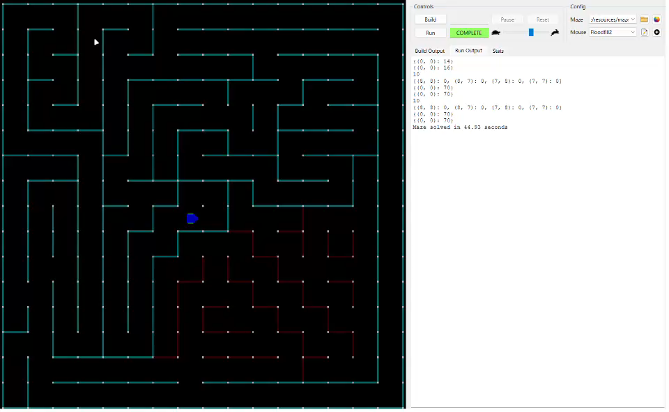
Final Simulation
Maze 1

Slide 10
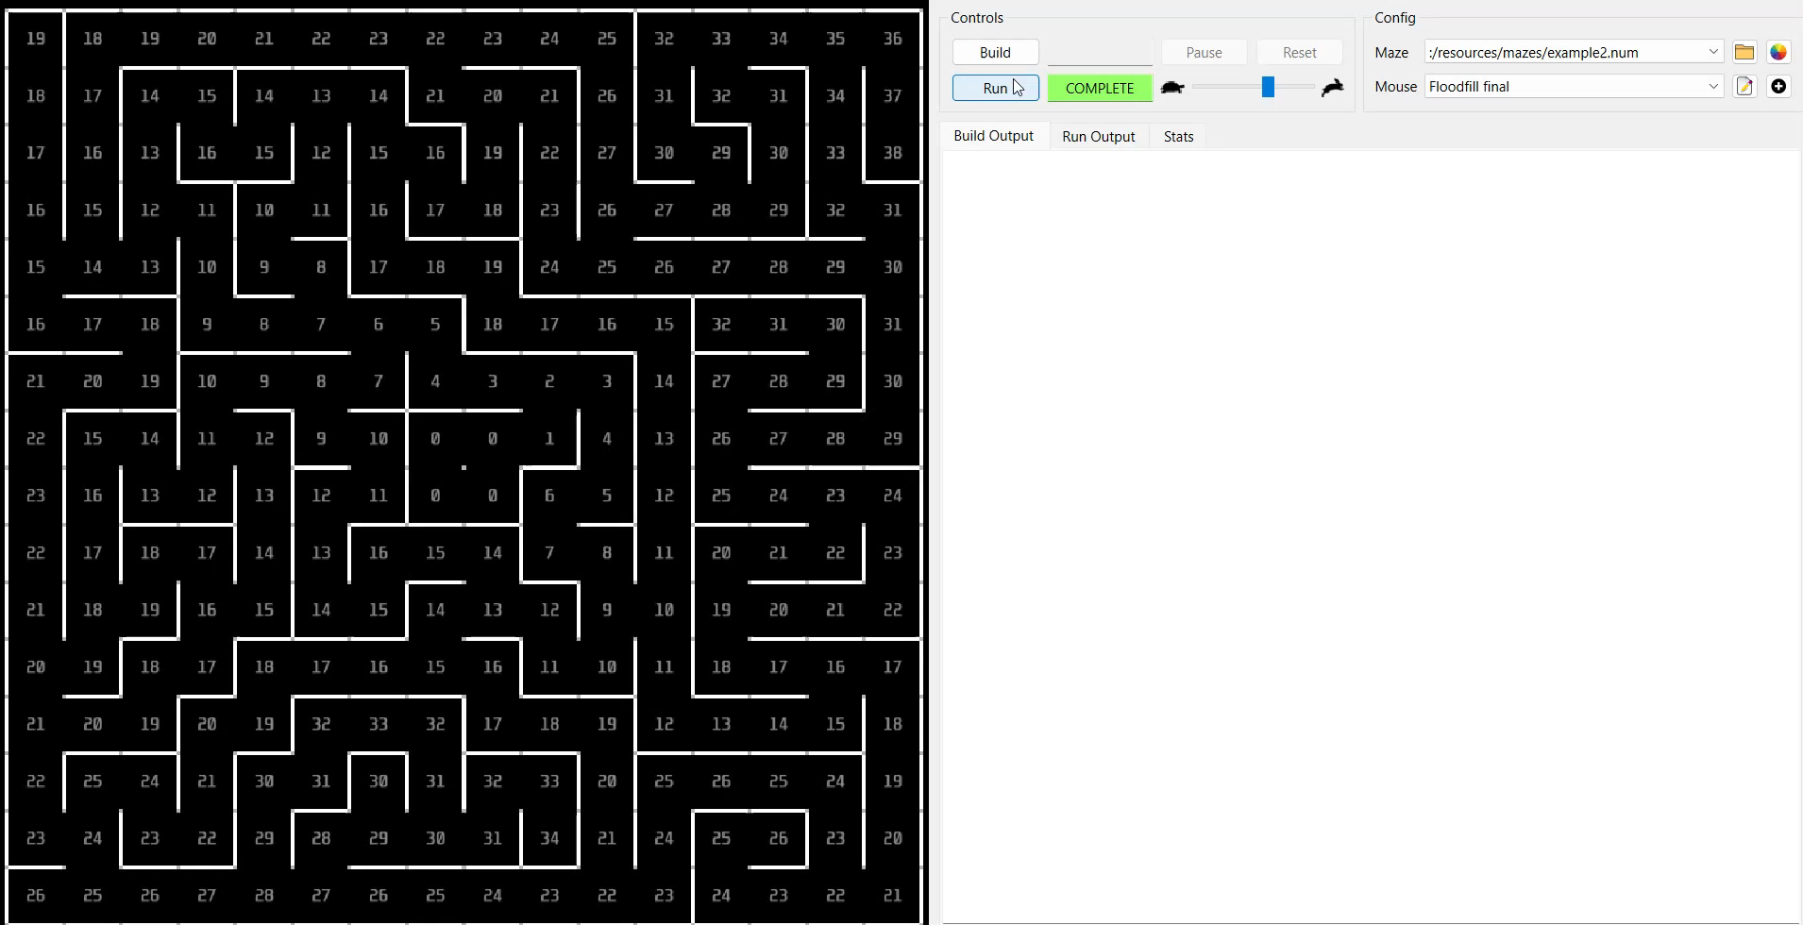
Maze 2

Slide 11
Hardware Elements Required
A micromouse robot necessitates a careful selection of components to ensure efficient navigation and maze solving capabilities. The core hardware elements include:
Microcontroller: The microcontroller serves as the robot's brain, handling sensor data, motor control, and algorithm execution. Its processing power, memory, and peripheral capabilities are crucial.
Sensors: To perceive the environment, a micromouse employs various sensors to detect maze walls for navigation, measure distances to obstacles, provide information about the robot's orientation and movement.
Motors: Driving the micromouse, motors are responsible for locomotion. Coreless DC motors are commonly preferred for their efficiency and precision.
Motor Driver: To interface between the microcontroller and motors, a motor driver is essential. It amplifies control signals and provides necessary current to the motors.
Power Source: A reliable power source, such as a battery pack, is required to supply energy to the entire system. Considerations include capacity, weight, and voltage compatibility.
By carefully selecting and integrating these components, a robust and efficient micromouse can be constructed.

Slide 12
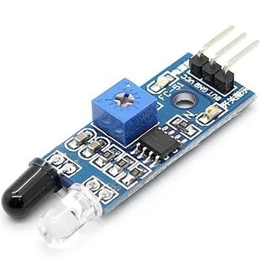
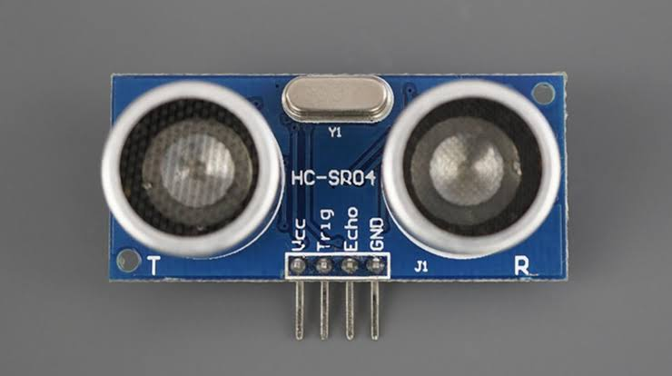
Sensor Selection
Infrared (IR) Sensors:
Proximity Detection
Short Range Accuracy
High Precision
Speed
Fast Response Time
Real-Time Processing
Size and Weight
Compact
Power Consumption
Low Power Requirements
Ultrasonic Sensors:
Distance Measurement
Longer Range
Versatility
Obstacle Detection
Wide Coverage
Reflection Handling
Integration benefits:
Enhanced Navigation: Combining IR and ultrasonic sensors allows the micromouse to have a more comprehensive understanding of its surroundings, leading to better navigation and obstacle avoidance.
Adaptive Strategies: The micromouse can adapt its navigation strategy based on the readings from both types of sensors, optimizing its pathfinding and maze-solving capabilities.
Error Reduction: Using multiple sensors reduces the likelihood of errors caused by sensor limitations or environmental factors, improving overall performance and reliability.
By leveraging the complementary strengths of IR and ultrasonic sensors, a micromouse can achieve more accurate, efficient, and reliable navigation in a maze environment.

Slide 13
Microcontroller Selection
A micromouse requires a microcontroller with sufficient processing power for real-time calculations, memory for maze mapping and pathfinding, and the ability to interface with various sensors and actuators. Given the constraints of size and power consumption, the choice is critical.
Arduino Nano
Pros: Easy to use, large community, ample pins.
Cons: Relatively high power consumption, limited processing power and memory for complex algorithms.
ATTiny1616
Pros: Extremely small, low power consumption.
Cons: Very limited processing power, memory, and pins. Not suitable for complex algorithms.
STM32 (e.g., F103C8T6)
Pros: High performance, low power consumption, wide range of models, flexible peripherals.
Cons: Steeper learning curve, more complex development environment.
ATMega128
Pros: Good balance of performance and memory, widely available.
Cons: Larger size compared to STM32 and ATTiny, higher power consumption than STM32.
Motorola hc182
Pros: High performance, large memory.
Cons: Very high power consumption, large size, outdated technology, limited availability.

Slide 14
Comparison Table
Microcontroller | Compact Size | No. of Pins | Processing Power | Memory Capacity | Power Consumption | Interface Complexity
Arduino Nano | Medium | 22 | Medium | Low | Medium | Low
ATTiny1616 | Small | 16 | Low | Very Low | Low | Medium
STM32 (e.g., F103C8T6) | Small | 32-100+ | High | Medium-High | Low-Medium | Medium-High
ATMega128 | Medium | 32 | Medium-High | Medium | Medium | Medium
Motorola hc182 | Large | 64 | High | High | High | High

Slide 15
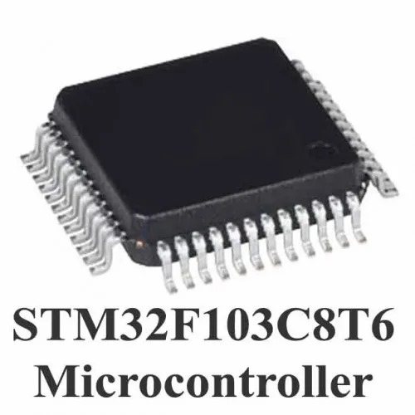
Recommended Microcontroller: STM32
According to our criteria for our micromouse project an STM32 microcontroller, specifically a smaller variant like the F103C8T6, is the most suitable choice.
Compact size: Ideal for fitting within the small micromouse chassis.
High processing power: Essential for real-time calculations and complex algorithms like flood fill.
Sufficient memory: For maze mapping and pathfinding data.
Low power consumption: Crucial for extending battery life.
Flexible peripherals: For various sensors and actuators.
While the initial learning curve might be steeper compared to Arduino, the long-term benefits in terms of performance and efficiency outweigh the drawbacks.

Slide 16
Motor Selection
When selecting motors for a micromouse robot, it's essential to consider factors such as precise control, power consumption, and compact size. Here is a comparison between several options:
Brushless DC Motors
Pros:
Simple Control:
Easy to control with basic on/off and speed control through PWM (Pulse Width Modulation).
High Speed:
Capable of achieving high rotational speeds, useful for rapid movement.
Compact and Lightweight:
Available in various small sizes, making them suitable for compact designs.
Cons:
Less Precision:
Lacks inherent position feedback, making precise control challenging without additional sensors (e.g., encoders).
Power Consumption:
Power consumption can be high, especially at higher speeds or under heavy loads.
Variable Torque:
Torque output varies with speed, potentially complicating control.

Slide 17
Stepper Motors
Pros:
High Precision:
Capable of precise control of position, speed, and rotation due to discrete step movements.
Repeatability:
Excellent repeatability without requiring feedback systems, making them ideal for precise navigation.
Holding Torque:
Can maintain a fixed position under load without continuous power consumption.
Cons:
Power Consumption:
Generally higher power consumption, especially when holding position.
Size and Weight:
Tend to be bulkier and heavier than other motor types of equivalent power output.
Complex Control:
Requires more complex control circuitry and algorithms compared to DC motors.
N20 12mm Micro Gearmotors
Pros:
Compact Size:
Extremely compact and lightweight, ideal for small and constrained spaces.
High Torque:
Integrated gearbox increases torque output, suitable for driving wheels in a micromouse.
Efficiency:
Generally efficient in converting electrical energy into mechanical motion.
Ease of Control:
Similar control to standard DC motors, typically through PWM for speed control.
Cons:
Speed Limitations:
Lower maximum speeds due to the gearbox, which might limit rapid movement capabilities.
Wear and Tear:
Gearbox components can wear out over time, potentially reducing lifespan and performance.
Precision:
Like other DC motors, lacks inherent position feedback, requiring additional sensors for precise control.

Slide 18
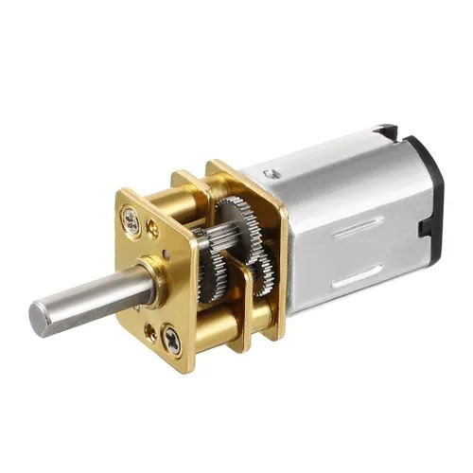
Comparison Table
Feature | DC Motor | Stepper Motor | N20 12mm Micro Gearmotor
Power Consumption | Moderate | High | Moderate
Compact Size | Compact | Bulky | Very Compact
Torque Output | Variable with speed | Consistent per step | High (due to gearbox)
Speed | High | Moderate | Moderate
According to our requirements, the best option is:
N20 12mm Micro Gearmotors: Excellent for compact, lightweight designs where moderate precision and high torque are needed. They strike a good balance between size, efficiency, and ease of control but might require additional components for precise navigation.

Slide 19
Motor Driver Selection
DRV8833 Dual H-Bridge Motor Driver
Pros:
Compact Size: Small and easy to integrate into tight spaces.
Voltage Range: Wide operating voltage range of 2.7V to 10.8V.
Current: Provides up to 1.5A continuous per channel.
Protection: Built-in current limiting, thermal shutdown, and under-voltage lockout.
Efficiency: Low power dissipation due to MOSFET-based H-bridges.
Cons:
Current Limit: May not be sufficient for high torque requirements of larger motors.
Use Case: Ideal for low-power, compact designs like a micromouse robot where space is a constraint.

Slide 20
L298N Dual H-Bridge Motor Driver
Pros:
Robustness: Can handle up to 2A per channel, suitable for more demanding applications.
Voltage Range: Operates from 5V to 35V, versatile for various motor types.
Popularity: Widely used and well-documented with extensive support.
Cons:
Size: Relatively large, which might be an issue in compact designs.
Efficiency: Higher power dissipation due to bipolar transistors, requiring heatsinking.
Use Case: Better suited for larger robots or applications where space is not a critical constraint and higher current handling is necessary.
TB6612FNG Dual H-Bridge Motor Driver
Pros:
Compact Size: Small footprint, similar to DRV8833.
Voltage Range: Operates from 2.5V to 13.5V.
Current: Supports up to 1.2A continuous per channel, 3.2A peak.
Protection: Built-in thermal shutdown and overcurrent protection.
Efficiency: Low power dissipation due to MOSFET-based H-bridges.
Standby Mode: Can save power when motors are not active.
Cons:
Current Limit: Similar to DRV8833, may not be suitable for very high current requirements.
Use Case: Excellent for micromouse robots due to its compact size, protection features, and low power dissipation.

Slide 21
4. MX1508 Dual H-Bridge Motor Driver
Pros:
Compact Size: Small and easy to integrate.
Voltage Range: Operates from 2V to 10V.
Current: Provides up to 1.5A per channel.
Cost: Generally more affordable.
Cons:
Less Robust: May not offer the same level of protection as other drivers.
Less Documentation: Less popular, potentially harder to find support and examples.
Use Case: Suitable for small projects where cost is a significant concern, but not the best choice for reliability and robustness.

Slide 22
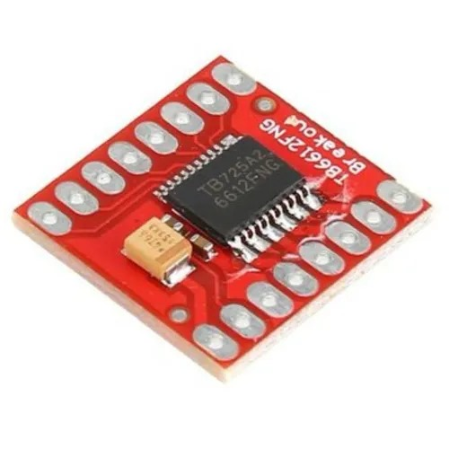
Comparison table
Feature | DRV8833 | L298N | TB6612FNG | MX1508
Voltage Range | 2.7V - 10.8V | 5V - 35V | 2.5V - 13.5V | 2V - 10V
Current per Channel | 1.5A continuous | 2A continuous | 1.2A continuous, 3.2A peak | 1.5A continuous
Size | Compact | Large | Compact | Compact
Efficiency | High | Medium | High | Medium
Protection | Yes | Limited | Yes | Limited
For our micromouse robot, where compact size, efficient power usage, and adequate protection features are crucial, the TB6612FNG Dual H-Bridge Motor Driver stands out as the best option. It offers a good balance of size, current handling, and protection features, making it a reliable choice for a small, agile robot like a micromouse.

Slide 23
Power Source Selection
Choosing the most efficient power supply for your N20 12mm micro gearmotors, TB6612FNG Dual H-Bridge Motor Driver, and STM32F103C8T6 microcontroller involves considering the voltage and current requirements of all components.
Voltage Requirements
N20 12mm Micro Gearmotors:
Typically operate within a voltage range of 3V to 12V. For optimal performance, 6V to 12V is common.
TB6612FNG Motor Driver:
Motor voltage (VM): 2.5V to 13.5V.
Logic voltage (VCC): 2.7V to 5.5V (typically 3.3V or 5V, provided by the microcontroller).
STM32F103C8T6 Microcontroller:
Operates at 3.3V.
Current Requirements
N20 Micro Gearmotors:
The current draw can vary significantly based on the load and operating voltage. Generally, it’s around 200mA to 300mA per motor at 6V, with higher currents possible under load.
TB6612FNG Motor Driver:
Can handle up to 1.2A continuous current per channel, with peaks up to 3.2A. Ensure your power supply can provide enough current for both motors simultaneously.
STM32F103C8T6 Microcontroller:
Low power consumption, typically around 50mA or less.

Slide 24
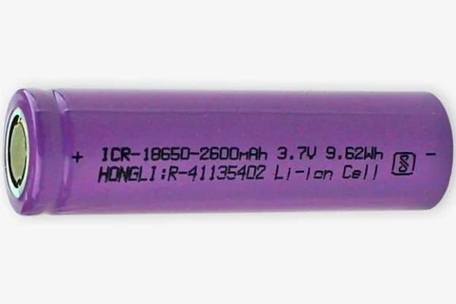
Suggested Power Supply Options
Li-Po or Li-Ion Battery Pack:
Voltage: 7.4V (2S) or 11.1V (3S) are common choices.
Capacity: Choose based on your runtime requirement, e.g., 1000mAh or higher.
Pros: Lightweight, high energy density, suitable for compact designs.
Cons: Requires a suitable charger and possibly a voltage regulator for 3.3V logic.
6V to 12V DC Power Adapter:
Voltage: Fixed output within the range (e.g., 9V or 12V).
Current: Ensure it can supply at least 2A.
Pros: Easy to use, no need for charging.
Cons: Less portable, requires a stable AC power source.
AA Battery Pack:
Configuration: 4x AA (6V) or 6x AA (9V) in series.
Capacity: Depends on the AA batteries used, typically around 2000mAh or higher.
Pros: Readily available, easy to replace.
Cons: Bulkier, heavier, may require a voltage regulator for 3.3V logic.
According to our requirements, 7.4V Li-ion Battery (or a pair of 3.7V Batteries) is the most suitable and efficient.

Slide 25
Further Vision
We have done our best to maximize the efficiency of the micromouse through both, the most suitable algorithm for maze solving combined with the compatible hardware components.
Due to limited resources and time constraints we could not really give this project the innovation to the fullest of its potential.
We plan to implement this algorithm on actual hardware assembled onto a compact chassis.
Increase the efficiency using diagonal turning to reduce turning time and incorporate vacuum fan to achieve higher friction at greater speed.
Solving simple mazes is not only what micromouse can do. It can revolutionise the whole navigation industry

Slide 26


